Slide 1


Slide 2


1. What is CORS
2. Types of CORS Requests
3. Types of CORS Misconfiguration
4. How to find Cors vulnerability
5. How to prevent Cors
6. Live Demo

Slide 3
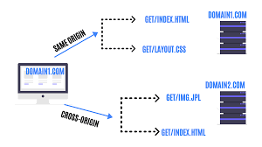
What is CORS?
CORS is standard of sharing cross-origin resources.
It is an HTTP-header based mechanism that allows a server to indicate any origins other than its own from which a browser should permit loading resources.
CORS adds new HTTP headers to the list of standard headers. The new CORS headers allow the local server to keep a list of allowed origins

Slide 4
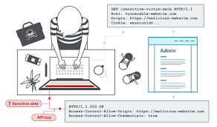
Any requests from these origins are granted and they’re permitted to use restricted assets. The header to add to the acceptable origins list is “Access-Control-Allow-Origin”.

Slide 5
Implementation in Real World
The most prevalent example of CORS are advertisements on non-native sites.
For example, imagine you’re watching a YouTube video and you see an Android advertisement. YouTube’s servers are reserved for their essential resources and cannot locally store every possible advertisement. Instead, all ads are stored on the advertisement company’s servers. The advertisement company has allowed viewing access to YouTube to allow a YouTube web page to play the stored Android advertisement video.

Slide 6
Types of CORS Requests
Most requests fall into two major categories:
Simple requests: These requests do not trigger a preflight check and use only “safelisted” CORS headers.
Preflight requests: These requests send a “preflight” message that outlines what the requester would like to do before the original request. The requested server reviews this preflight message to ensure the request is safe to allow.

Slide 7
Types of CORS misconfigurations
CORS contains two main components that when misconfigured can pose a significant risk to any web application:
Access-Control-Allow-Origin (ACAO): This allows for two-way communication with third-party websites. To modify sensitive data such as usernames or passwords
Access-Control-Allow-Credentials (ACAC): This allows third-party websites to execute privileged actions that only the genuine authenticated user should be able to perform. Changing your password or your contact information.

Slide 8
How to find CORS
Request :-
Origin: attacker.com
Response :-
Access-control-allow-origin: attacker.com
Access-control-allow-credentials: true
Response :-
Access-control-allow-origin: null
Access-control-allow-credentials: true
Request :-
Origin: attacker.com
Request :-
Origin: attacker.com
Response :-
Access-control-allow-origin: *
Access-control-allow-credentials: true

Slide 9
Exploiting misconfigured wildcard (*) in CORS Headers
Consider the below request:
GET /api/userinfo.php Host: www.victim.com Origin: www.victim.com
When you send the above request, you get a response with the Access-Control-Allow-Origin header setting. See the below response code
HTTP/1.0 200 OK Access-Control-Allow-Origin: * Access-Control-Allow-Credentials: true
The header is configured with a wildcard(*). It means any domain can access the resources.

Slide 10
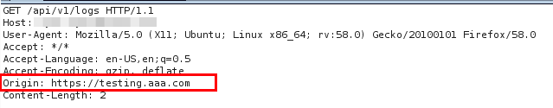
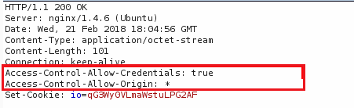
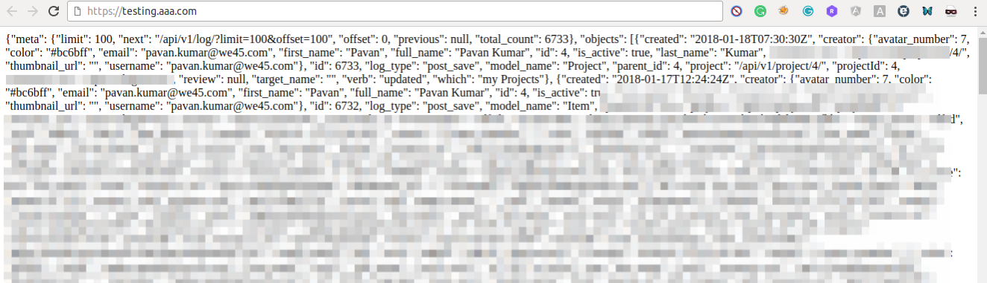
We can modify the REQUEST Origin from victim domain to attacker domain.
Here, https://testing.aaa.com is our attacker’s domain
Below is the response we received. The wildcard is shown in the origin header response with Access-Control-Allow-Origin: *, which means victim domain allows access to resources from all sites. Testing.aaa.com site in our attack case.
This Kind of information you can gather with this attack

Slide 11
How to Prevent ?
Specify the allowed origins
Only allow trusted sites
Don’t whitelist “null”
Implement proper server-side security policies
Enable SOP (Same origin policy)
Using a firewall
Cors Resources and cheatsheets:
https://0xn3va.gitbook.io/cheat-sheets/web-application/cors-misconfiguration
https://github.com/EdOverflow/bugbounty-cheatsheet/blob/master/cheatsheets/cors.md
https://www.kyylee.com/websec-101/cors
https://www.packetlabs.net/cross-origin-resource-sharing-cors/
https://portswigger.net/web-security/cors
https://medium.com/@amangupta566/cors-misconfiguration-leads-to-steal-sensitive-information-disclosure-fdf050b68b66

Slide 12
Thank you

